Slide 1


Text summarization

Slide 2
Table of contents
02
Data pre-processing
03
Feature Engineering
01
Problem Formulation
04
Classification
05
06
Text summary
Clustering
07
Question &
Answering
08
Innovation

Slide 3
Problem formulation
01

Slide 4
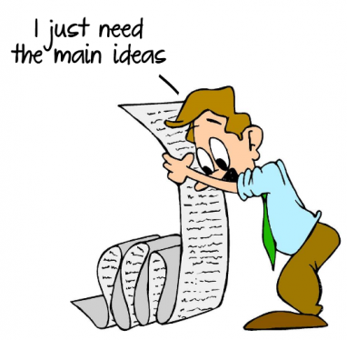
Problem formulation
People Spend more time reading articles so we used text summarization to get the most precise and useful information from large articles and eliminate the irrelevant or less important ones.

Slide 5
Data pre-processing
02

Slide 6

Data Pre-processing
1- Make an ID for each label in the dataset.
2- Remove Stop words but keep comma and full stops.
3- Apply lemmatization and stemming.
4- Apply tokenization.
5- Remove Rows where the summary is longer than the original text.
6- split text into sentences to give each one a score.

Slide 7
Feature Engineering
03

Slide 8
BOW
TF-IDF
A bag of words is a representation of text that describes the occurrence of words within a document.
Term frequency (TF) vectors show how important words are to documents.

Slide 9
Classification
Models | KNN | SVM | Decision Tree
BOW Training | 84% | 98% | 98%
TF-IDF Training | 70% | 97% | 98%
BOW Testing | 69% | 93% | 86%
TF-IDF Testing | 59% | 95% | 85%

Slide 10
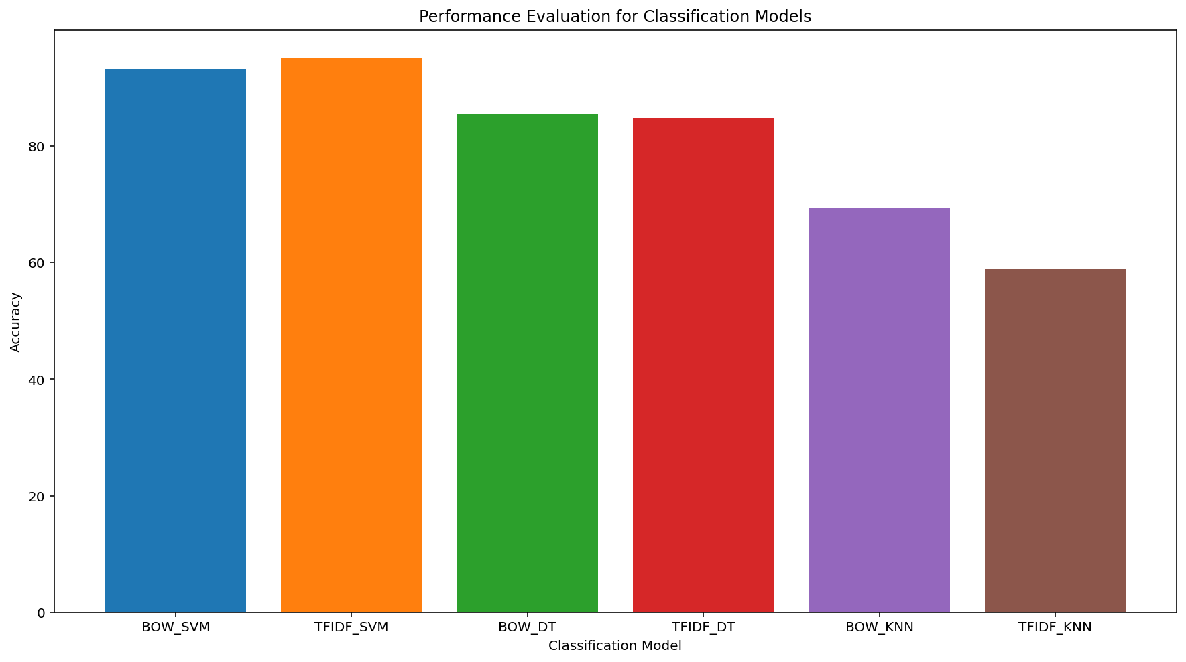
Classification accuracies

Slide 11
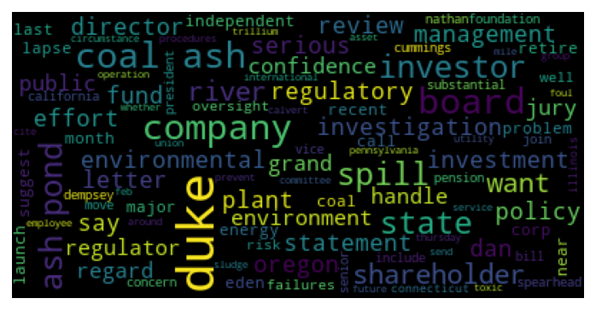
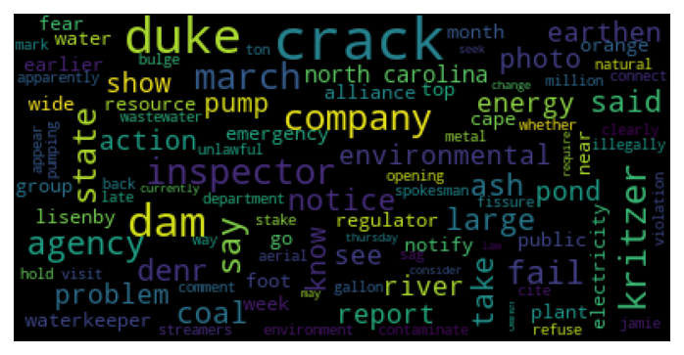
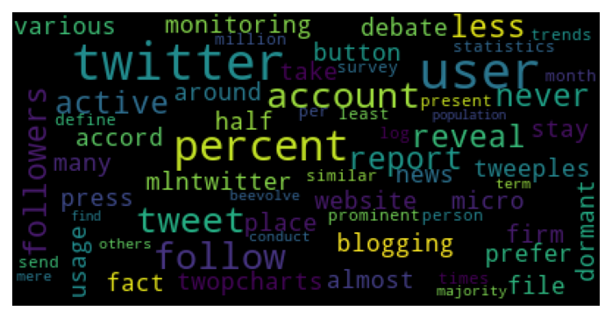
Error Analysis

Slide 12
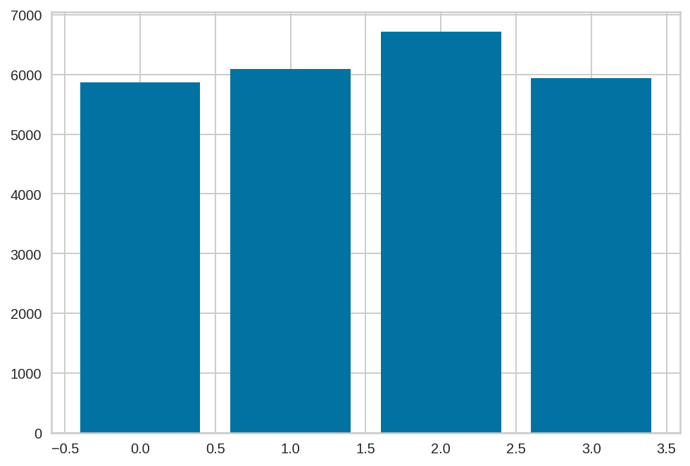
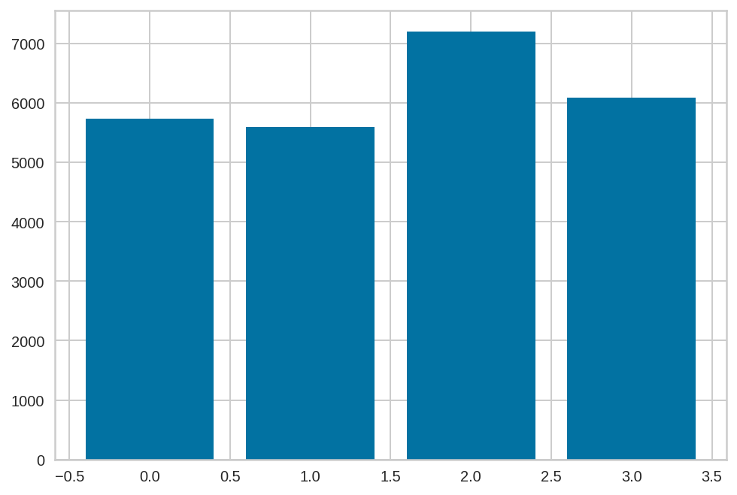
Clustering
K-means
TF-IDF
BOW

Slide 13
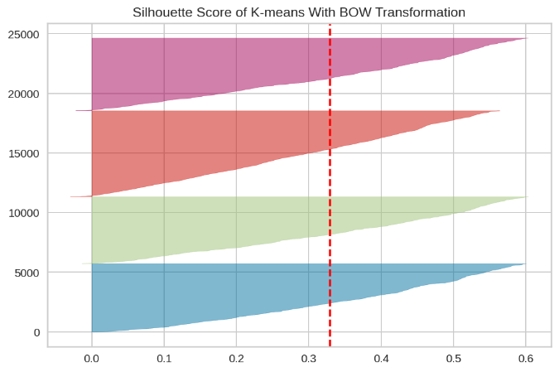
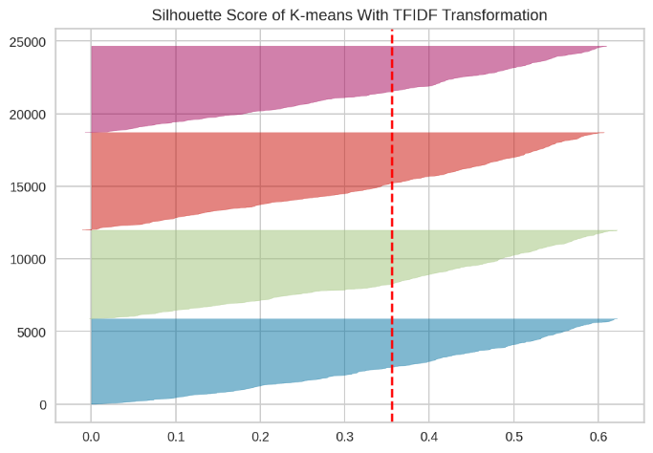
Clustering
Silhouette score with BOW | Silhouette score with TF-IDF
0.32953 | 0.35619
After performing Error Analysis, the best number of K is K =4

Slide 14
Text summarization

Slide 15
Our Techniques
BERT
Latent Semantic Analysis is a robust algebraic-Statistical method which extracts hidden semantic structures of words and sentences. it extracts the features that cannot be directly mentioned. These features are essential to data, but are not original features of the dataset. It is an unsupervised approach along with the usage of Natural Language Processing (NLP).
LSA
BERT (Bidirectional transformer) is a transformer used to overcome the limitations of RNN and other neural networks as Long term dependencies. It is a pre-trained model that is naturally bidirectional. This pre-trained model can be tuned to easily to perform the NLP tasks as specified, Summarization in our case.

Slide 16
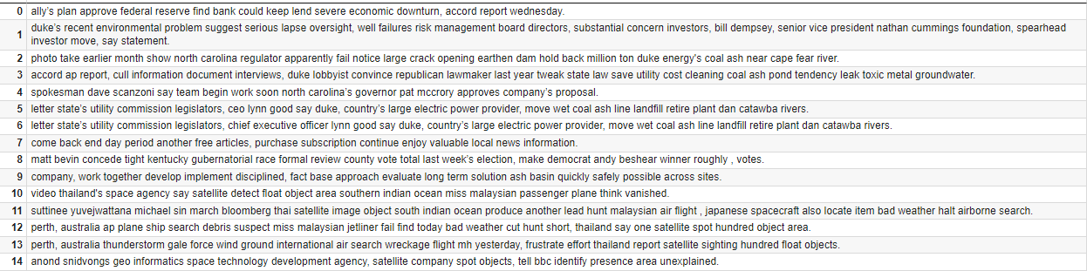
Our Techniques
LSA

Slide 17
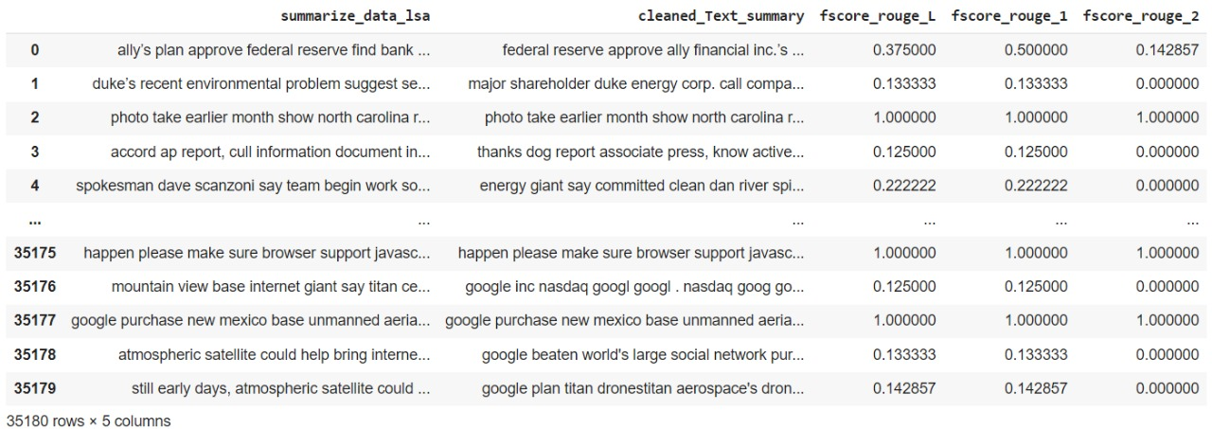
LSA Evaluation

Slide 18
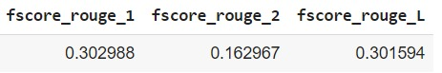
LSA Evaluation

Slide 19
Our Techniques
BERT
1- Divide the text into sentences.
2- Make a word embedding for each sentence.
3- Every sentence have a point.
4- Put every point in a cluster.
5- Calculate the distance between the point and the centroid.
5- Take the closest point to the centroid.
6- Extract the summary

Slide 20
LSA vs. BERT
Precision score is used to measure the model performance in measuring the count of true positives in the correct manner out of all positive predictions made.
Recall score is used to measure the model performance in terms of measuring the count of true positives in a correct manner out of all the actual positive values.
F1-score is harmonic mean of precision and recall score and is used as a metrics in the scenarios where choosing either of precision or recall score can result in compromise in terms of model giving high false positives and false negatives respectively.
{'r': 0.7142857142857143, 'p': 0.625, 'f': 0.6666666616888889}
{'rouge1': Score(precision=0.2857142857142857, recall=1.0, fmeasure=0.4444444444444445)}

Slide 21
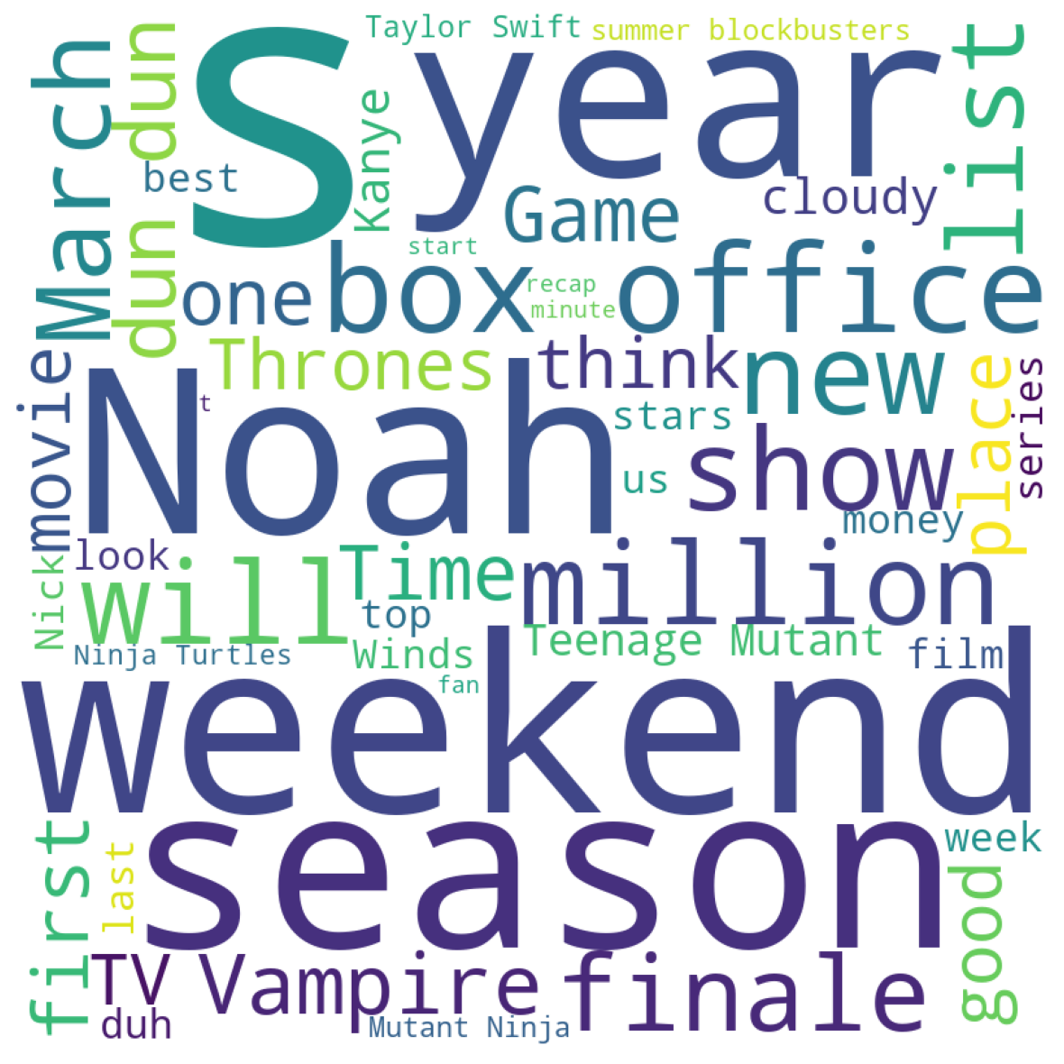

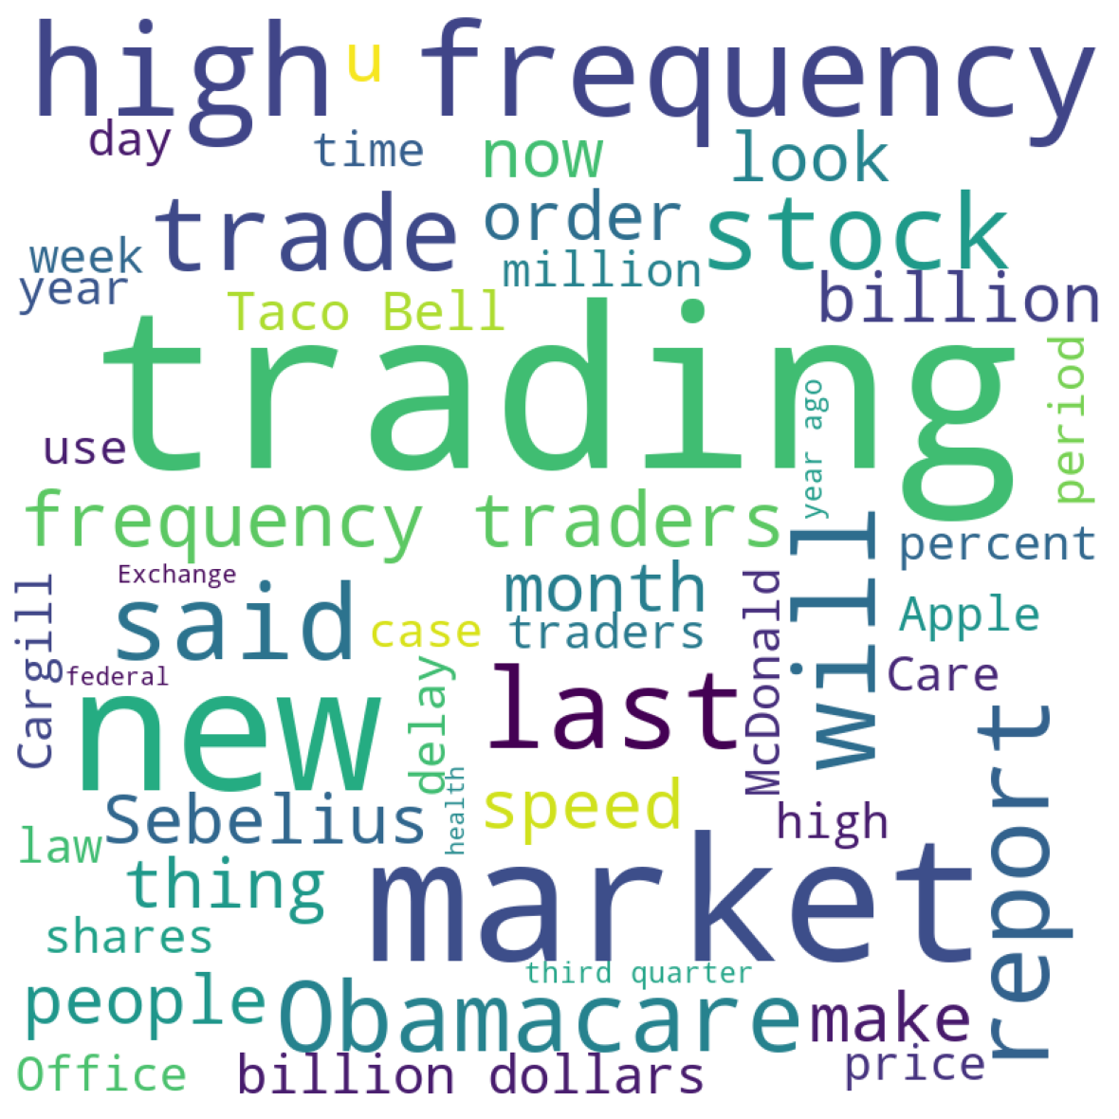

Error Analysis

Slide 22
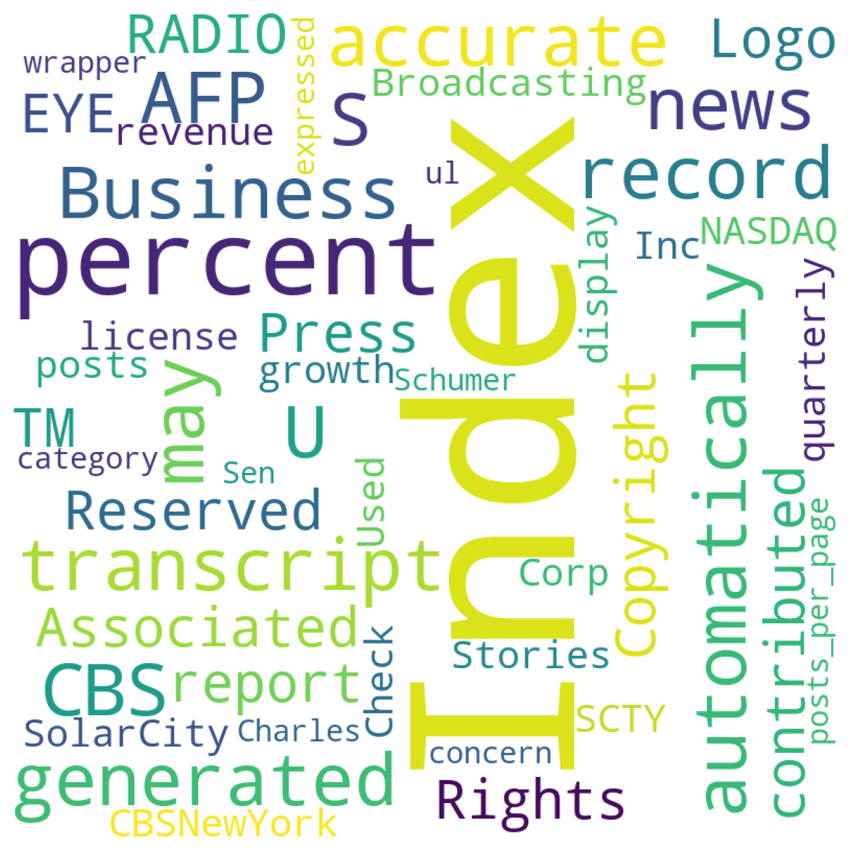
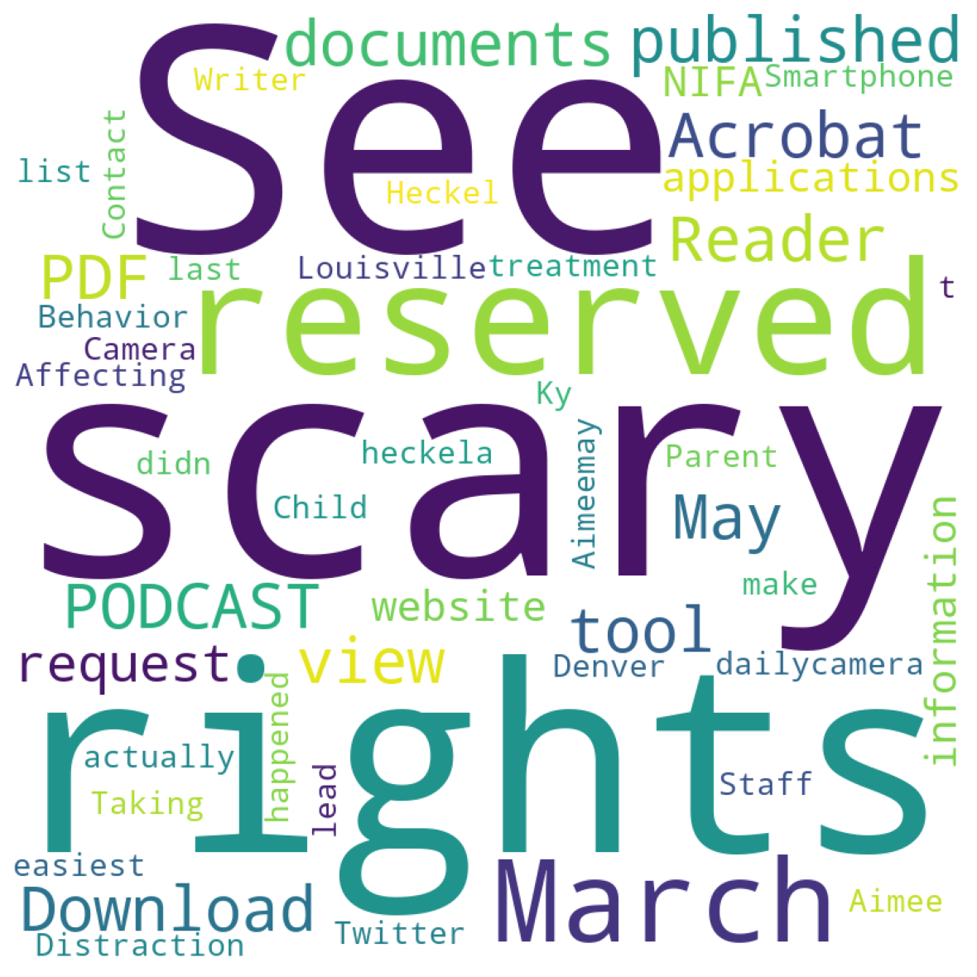
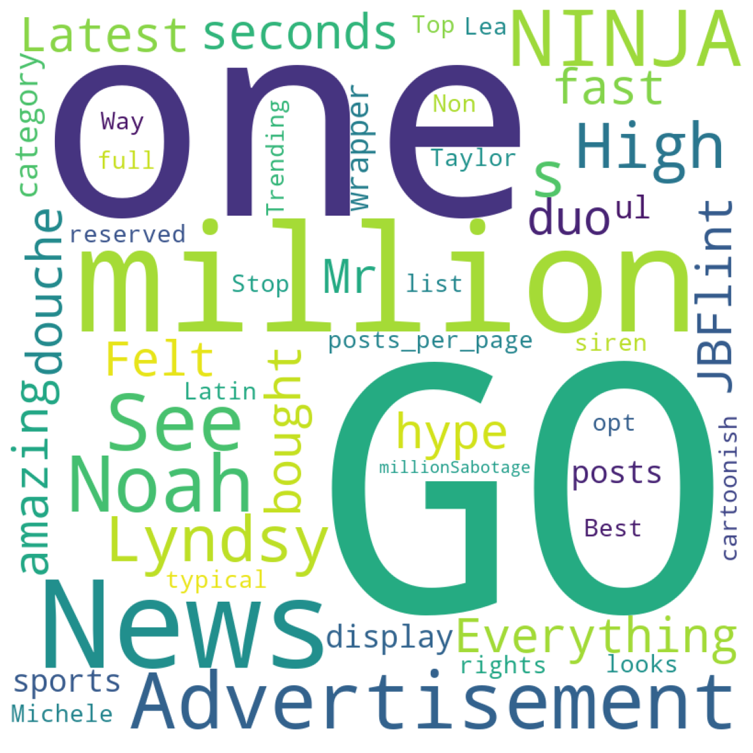
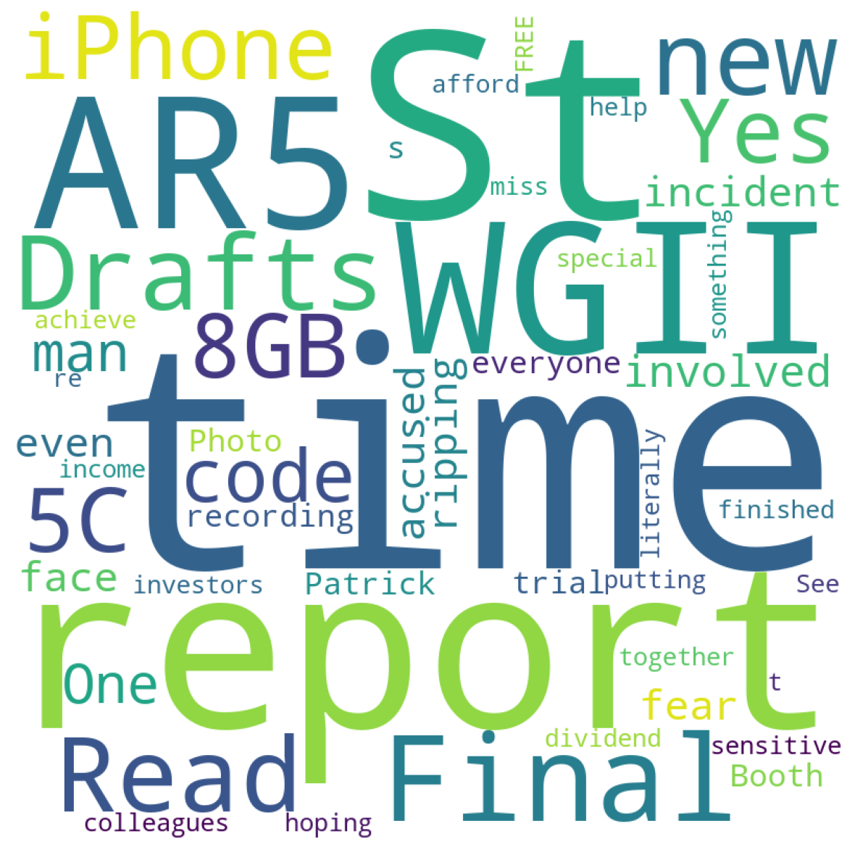
Let’s see what the machine managed to capture

Slide 23
Let’s see what the machine managed to capture
Machine is focused more on names of news outlets and names of stock markets more than words correlated with the business world
The human summary focused on what is going to happen and when while the machine was distracted to flashy news titles like Amazing, Go, News.
The human summary focused on food safety and the diseases related to corruption of food crops while the machine was distracted by where the news was found like twitter, podcast or website, but still managed to capture scary and rights which are in a way related to the topics in this rows but not enough.
Machine seemed to have focused on unnecessary details here,that may be included in an article but focusing on the importance of technology instead of the real news like google did so or Apple released something new.

Slide 24

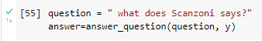
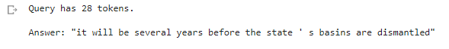
Chat bot
Question and answering system that extracts the answer from the text summary from Bert and LSA.

Slide 25
Innovation
Our Innovation is machine language translation on the summary or the original text, from English language to German, Chinese, and Arabic languages.
Original text to Translate
The energy giant says it is committed to cleaning up the Dan River spill site and will not increase customer rates to cover the expense.\nDuke Energy is adding a new element to dealing with its coal ash basins.\nWednesday, the company announced it will hire an independent team of engineers to review the condition of its sites.\nSpokesman Dave Scanzoni says the team will begin working as soon as North Carolina’s Governor Pat McCrory approves the company’s proposal.\n If we see any issues that need to be addressed, we’ll take care of them immediately.”This effort is in response the Dan River spill on February 2.

Slide 26
Innovation
English to German Translation
Der Energieriese sagt, dass es sich zur Reinigung der Dan River Spill Website verpflichtet und wird nicht die Kundenpreise erhöhen, um die Kosten zu decken. Duke Energy fügt ein neues Element in den Umgang mit seinen Kohleasche Becken. Mittwoch, das Unternehmen kündigte an, es wird ein unabhängiges Team von Ingenieuren zu mieten, um den Zustand seiner Standorte zu überprüfen. Sprecher Dave Scanzoni sagt, dass das Team beginnt zu arbeiten, sobald North Carolina Gouverneur Pat McCrory genehmigt den Vorschlag des Unternehmens. Wenn wir irgendwelche Probleme sehen, die behandelt werden müssen, werden wir uns sofort um sie kümmern.

Slide 27
Innovation
English to Chinese Translation
能源巨人说,该公司致力于清理丹河溢漏点,不会提高客户费率以支付费用。 杜克能源公司正在为其煤灰盆地的处理增加一个新的要素。 星期三,该公司宣布它将雇用一个独立的工程师小组来审查其矿址的状况。 发言人戴夫·斯坎佐尼说,该小组将在北卡罗来纳州州长帕特·麦克罗里批准该公司提案后立即开始工作。 如果我们看到任何需要解决的问题,我们将立即处理。 “这一努力是为了应对2月2日丹河泄漏事件。 ”

Slide 28
Innovation
English to Arabic Translation
يقول العامل العامل في مجال الطاقة إنه ملتزم بتنظيف موقع انسكاب نهر دان ولن يزيد أسعار العملاء لتغطية النفقات. إن شركة الدوق للطاقة تضيف عنصراً جديداً للتعامل مع أحواض رماد الفحم لديها. يوم الأربعاء، أعلنت الشركة أنها سوف تستأجر فريقاً مستقلاً من المهندسين لاستعراض حالة مواقعها. والناطق باسم ديف سكانزوني يقول إن الفريق سوف يبدأ العمل بمجرد أن يوافق محافظ كارولينا الشمالية بات ماكروري على اقتراح الشركة. وإذا رأينا أي قضايا تحتاج إلى معالجة فسوف نعتني بها على الفور". وهذا الجهد يأتي استجابة لانسكاب نهر دان في الثاني من فبراير/شباط.

Slide 29
Conclusion
After cleaning and preprocessing, we used 2 different transformation methods to apply text clustering and classification. Then, we applied 2 different clustering and classification algorithms to these 2 methods. and we used Bert and LSA to Summarize the text.
After comparing the results, we noticed that the LSA summary is closest to the human summary, but the BERT summary is not.

Slide 30
References
https://ieeexplore-ieee-org.proxy.bib.uottawa.ca/document/9395976/figures#figures
https://www.codegrepper.com/code-examples/python/NLP+text+summarization+with+LSA
https://pypi.org/project/bert-extractive-summarizer/
https://towardsdatascience.com/how-to-detect-and-translate-languages-for-nlp-project-dfd52af0c3b5

Slide 31
Thanks!
Basma Abd-Elwahab
Amir Safwat
Nada Ashraf
Yasmine mohamed

